Slide 1
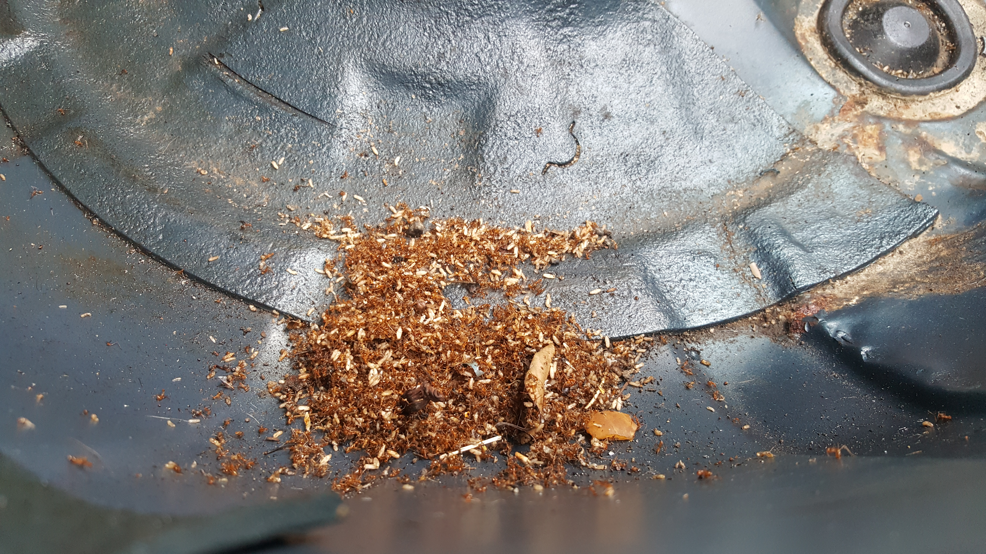
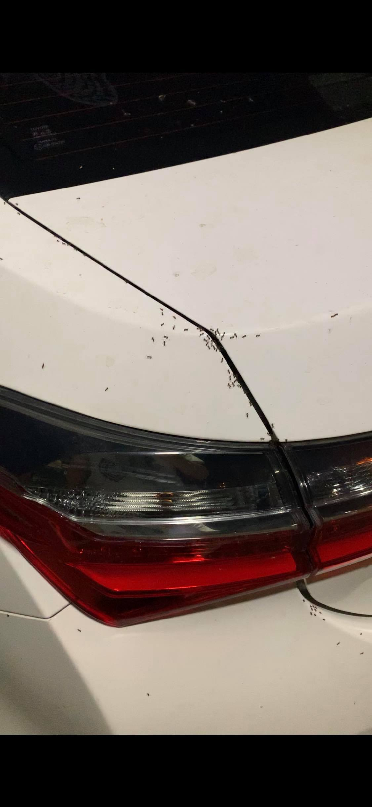
(a)
(b)
(c)

Slide 2
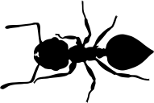
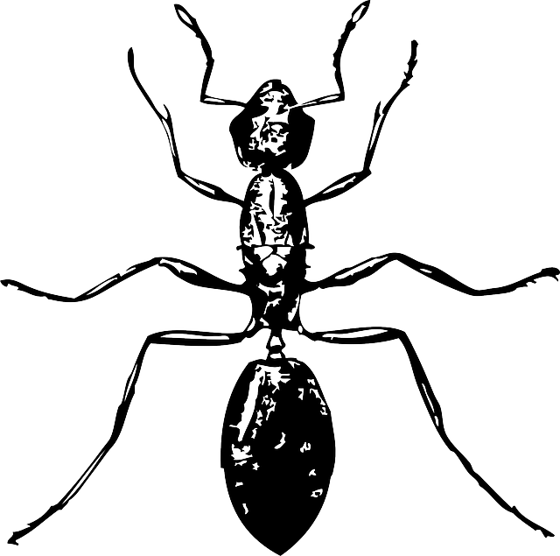

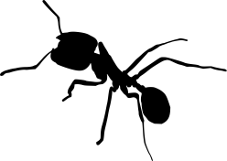

Behavior
(searching activity)
Morphology
(climbing ability)
Physiology
(thermal tolerance)
Ecology
(habitat use)

